Slide 1
CSS PROPERTIES
Presented by: Enas Ibraiwesh, Lina Badawi, , Zayna Amierh and Heba Hanandeh

Slide 2
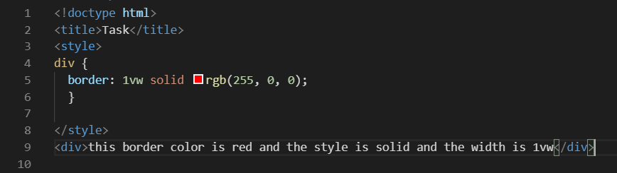
Border
The border property is a shorthand property for the border-width, border-style, and border-color properties.
If you need to apply a different style to each border, you will need to use one of the other, more specific, border properties (for example, border-top, border-top-color, border-style, etc)
Syntax:
border: <line-width> || <line-style> || <color>
<line-style> = none|hidden|dotted|dashed|solid|double|groove|ridge|insert|outset

Slide 3
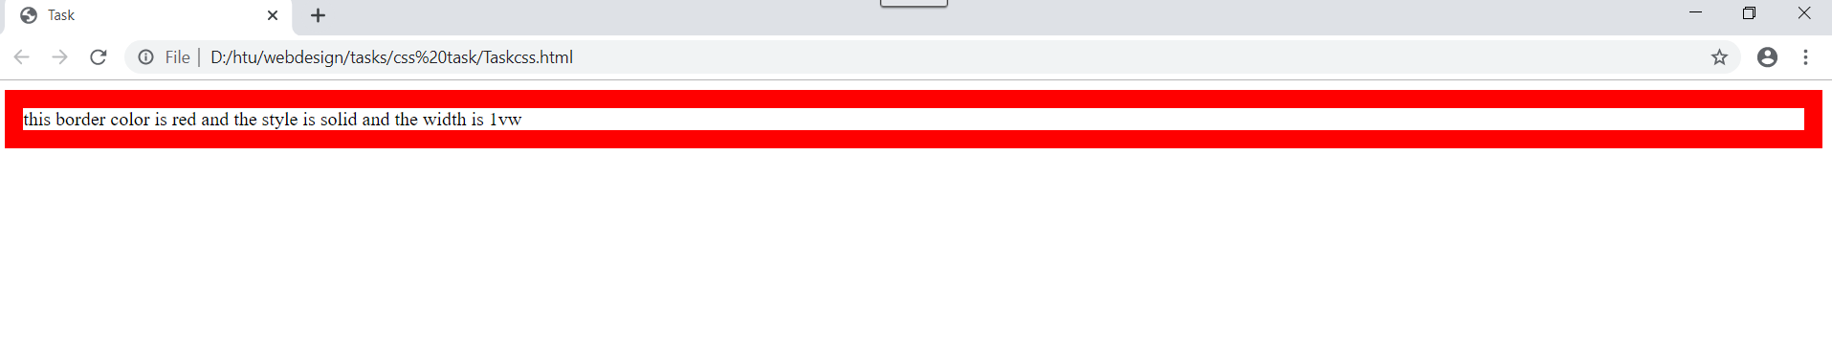
OUTPUT

Slide 4
Outline
An outline is a line that is drawn around elements, OUTSIDE the borders, to make the element "stand out".
The outline property is a shorthand property for setting the following individual outline properties:
outline-width
outline-style (required)
outline-color
The outline property is specified as one, two, or three values from the list above. The order of the values does not matter.

Slide 5
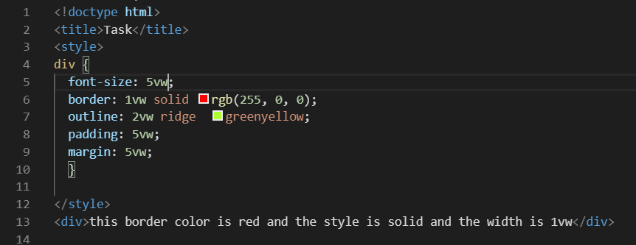
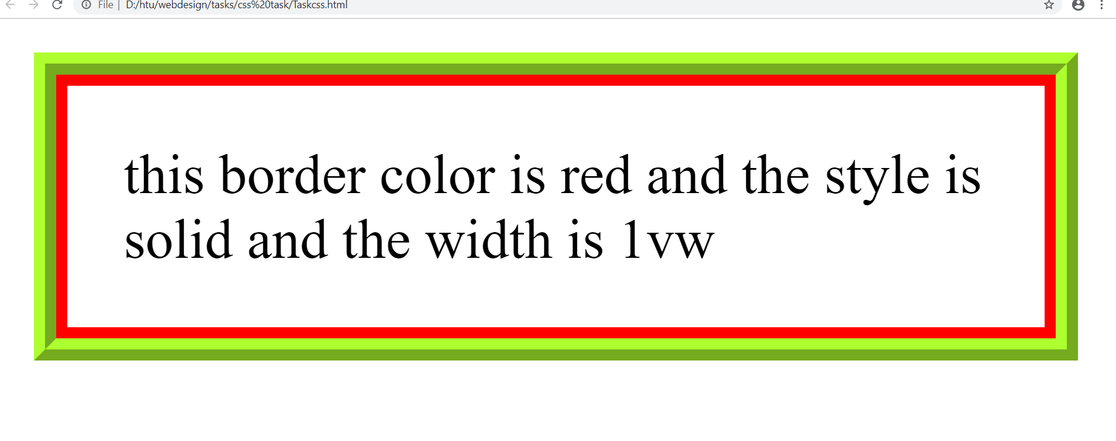
OUTPUT

Slide 6
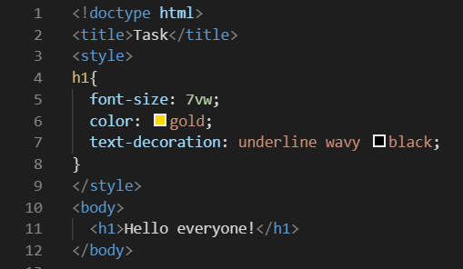
Text decoration
The property is a shorthand property for setting text-decoration-line, text-decoration-style, and text-decoration-color in one
declaration.
Syntax:
text-decoration: <text-decoration-line> || <text-decoration-style> || <text-decoration-color>
Text-decoration-line : none, underline, overline, line-through.
Text-decoration-style : solid, wavy, dotted, dashed, double

Slide 7
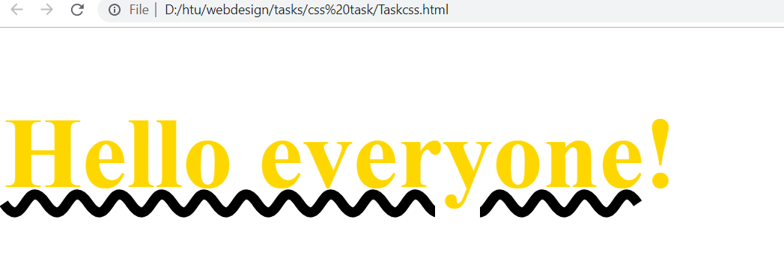
OUTPUT

Slide 8
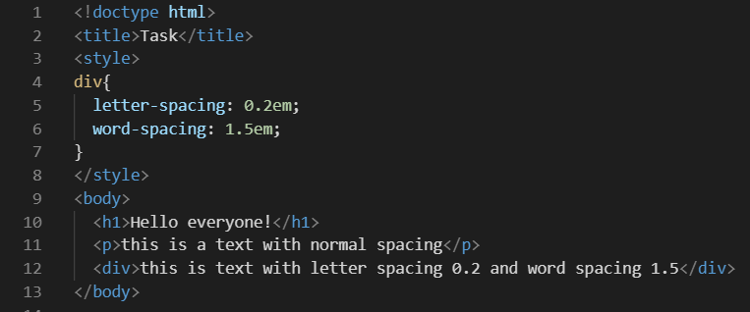
Word spacing & Letter spacing
controls the space between words and adjusting the space between each letter.
Syntax
word-spacing: [ normal | <length> | <percentage>]
Syntax:
letter-spacing: normal | <length>

Slide 9
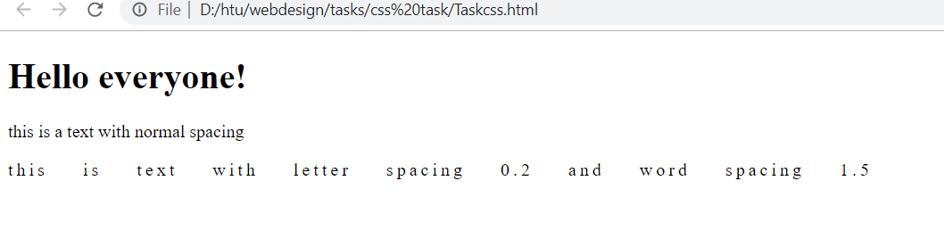
OUTPUT

Slide 10
Direction & Unicode-bidi
Direction
The direction property specifies the text/ writing direction within a block-level element.
The syntax property values include:
ltr (Left-to-right direction) Rtl (Right-to-left direction)
Initial (Sets this property to its default value.)
Inherit (takes the value from the parent element)

Slide 11
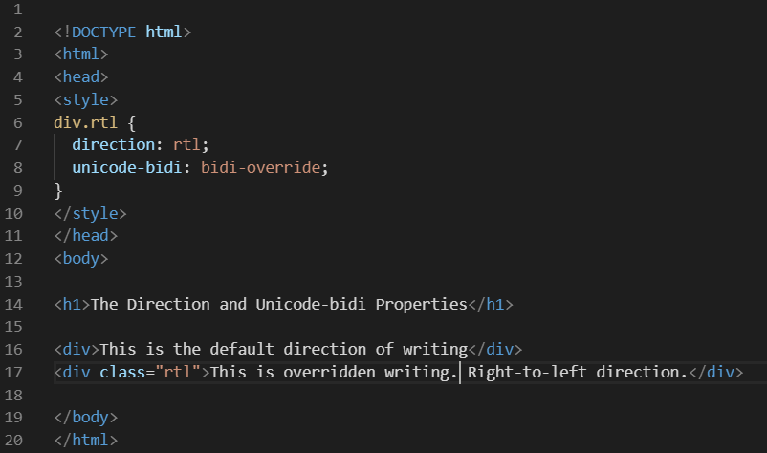
Unicode-bidi:
This is the property which is used together with the direction property to set whether the text should be overridden to support multiple languages in the same document.
The syntax property values may include:
Normal
Embed
Bidi-override
Isolate
Initial
Inherit

Slide 12
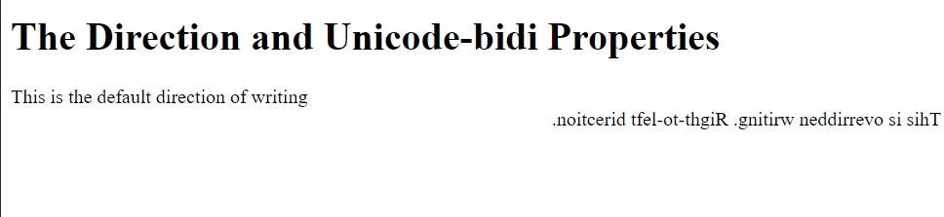
OUTPUT
Tip: Use this property together with the unicode-bidi property to set or return whether the text should be overridden to support multiple languages in the same document.

Slide 13
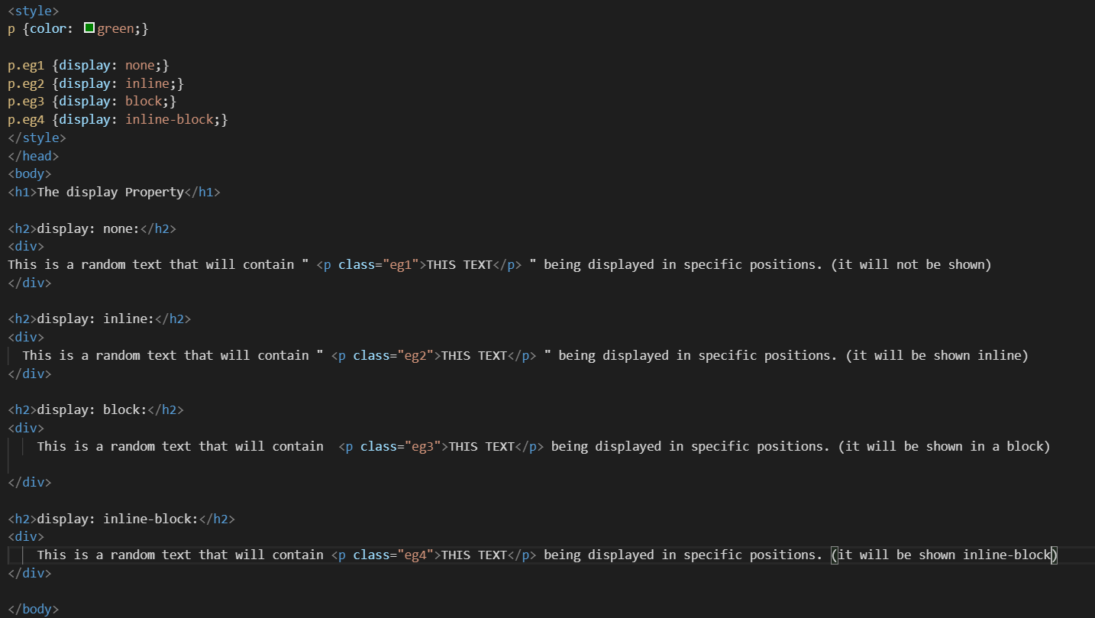
Display
This is the property that specifies the display behavior of an element

Slide 14
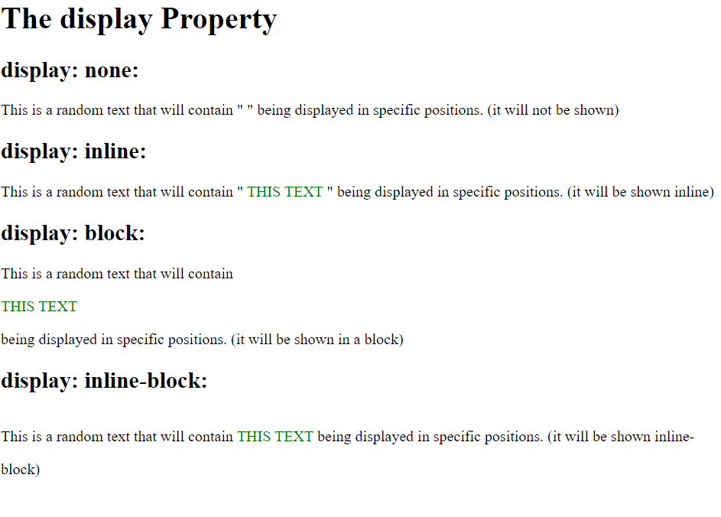
OUTPUT

Slide 15
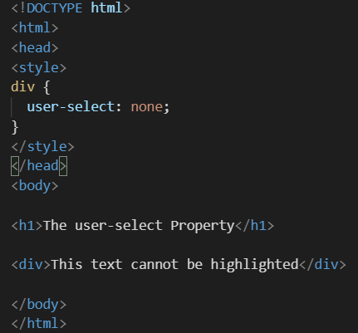
User-Select
This property specifies whether the text of an element can be selected.
Property values are auto, none, text, all.

Slide 16
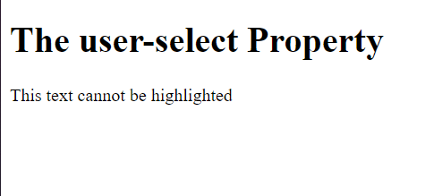
OUTPUT

Slide 17
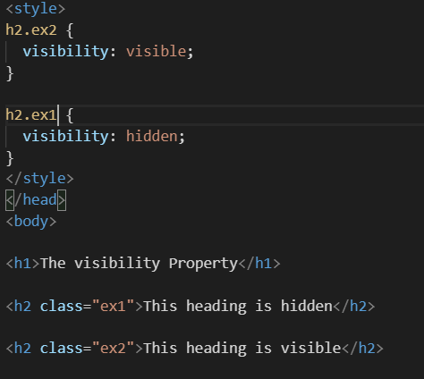
Visibility
This property is used to define whether the element is visible or not.
Property values include: visible, hidden
Note: the hidden text will still take up space.

Slide 18
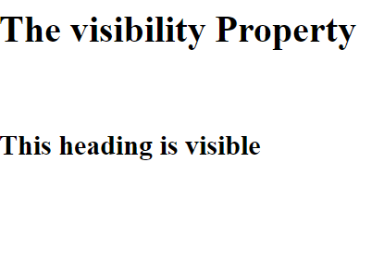
OUTPUT

Slide 19
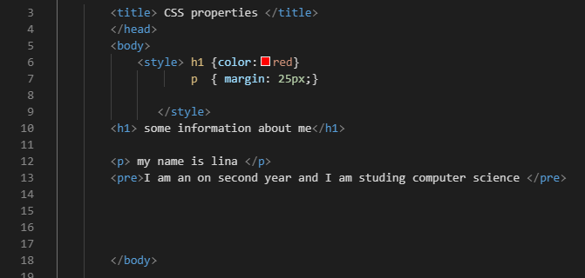
Margin
The margin property sets the margins for an element, and is a shorthand property for the following properties:
margin-top
margin-right
margin-bottom
margin-left
If the margin property has four values:
margin: 10px 5px 15px 20px;
top margin is 10px
right margin is 5px
bottom margin is 15px
left margin is 20px

Slide 20
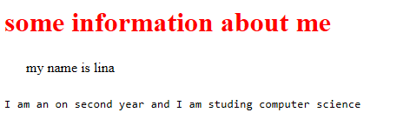
OUTPUT

Slide 21
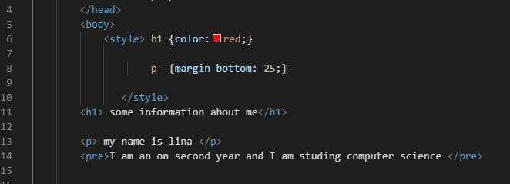
Margin-bottom
The margin-bottom property sets the bottom margin of an element.

Slide 22
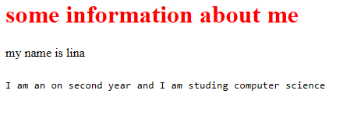
OUTPUT

Slide 23
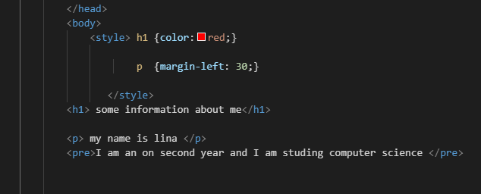
Margin-left
The margin-left property sets the left margin of an element.

Slide 24
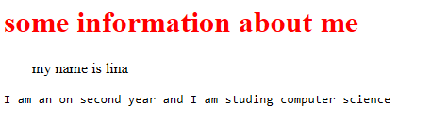
OUTPUT

Slide 25
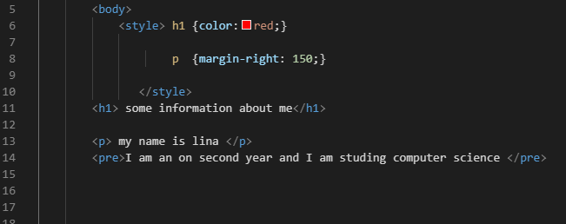
Margin-right
The margin-right property sets the right margin of an element.

Slide 26
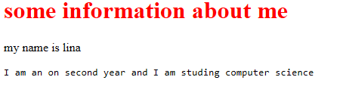
OUTPUT

Slide 27
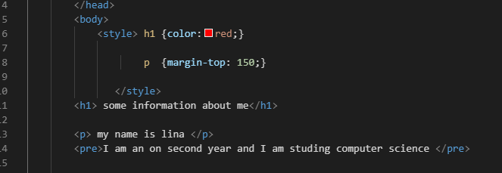
Margin-top
The margin-top property sets the top margin of an element.

Slide 28
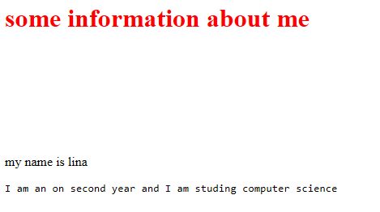
OUTPUT

Slide 29
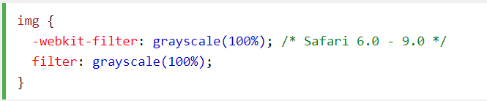
Filter
The filter property in CSS allows us to apply effects such as color change and blur to an element, and filters are generally used to modify the view of <img> images, backgrounds, and border frames

Slide 30

grid-gap
The grid-gap property in CSS is an abbreviated property that sets the grid-row-gap and grid-column-gap properties, and specifies the space between lines and columns in a gird container.

Slide 31
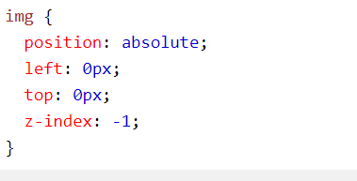
z-index
The z-index property is used to offset elements on the z axis to determine the order of overlapping elements on each other

Slide 32
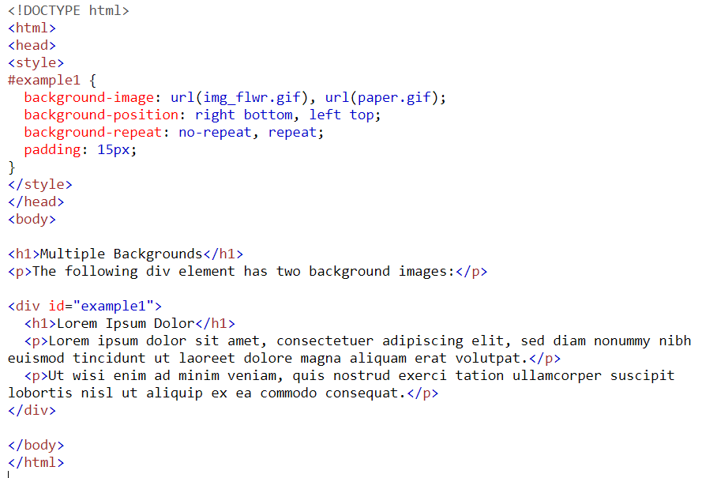
background-image
Sets one or more images as the background of the item.

Slide 33
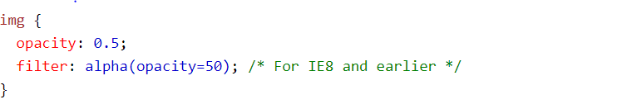
opacity
Determines the transparency of an item, that is, the extent to which the content behind it appears.

Slide 34


